Slide 1
MLK CELEBRATION BASKETBALL SHOWCASE
BY KIRVEN R LANG JR

Slide 2
Introduction/Purpose of Event
The purpose of the event is to celebrate the birthday of Dr. Martin Luther King Jr., while fulfilling his dream of kids of all colors being able to play together with no malice.
Hosted at Bishop State Community College in Mobile, Alabama
Two day event held on Saturday and Monday of MLK Day

Slide 3
Bishop State’s MLK Day Celebration

Slide 4
Goals
One of the main goals is to continue to fulfill Dr. King’s dream of kids of all colors having the ability to play together without any turmoil or racial mindsets.
By doing so, our selection of teams was very open, and not just limited to predominantly black schools in which most MLK Day showcase events usually host.
This is also a huge fundraising event for our men’s basketball team at Bishop State.
We used this event to allow our players to work, which puts money in their pockets. The MLK Celebration also helps fund our team throughout the season.

Slide 5
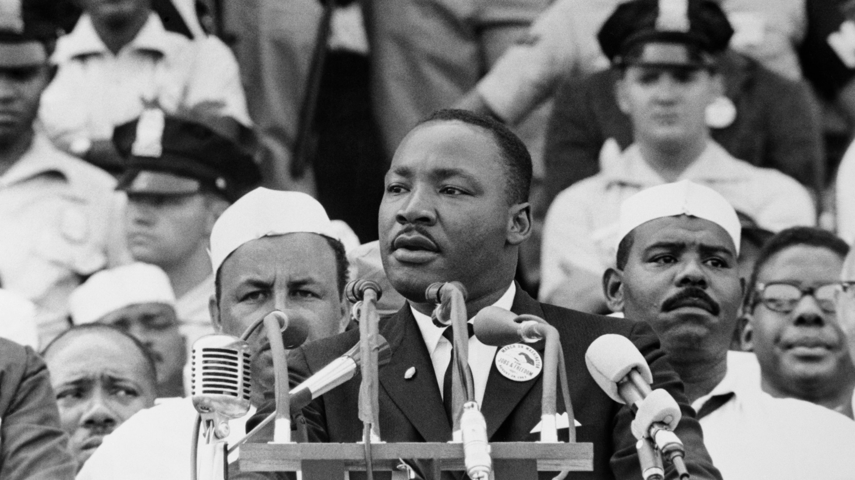
Dr. Martin Luther King’s I Had A Dream Speech

Slide 6
Target Market/Attendance
Parents of all colors attend our event and share the same space just as the kids do.
This also affords parents that have to work during their kid’s games, the opportunity to see their kids play as they are more than likely off on Saturday and the MLK holiday.
From an attendance standpoint, our goal was to attract 20 middle school teams, boys and girls included, and 6 varsity boys’ basketball teams.
We anticipate each team brings 100-150 spectators each team for the middle school games and a capacity crowd of 750 spectators for the varsity games.

Slide 7
Fans Attending The MLK Celebration

Slide 8
SWOT Analysis
Strengths - Our connections and relationships in the community was one of our key strengths to drawing good teams and crowds. Another key strength is, we used our own gym and campus police.
Weaknesses - A weakness is the facility, as there are numerous entry points which needed more security to man doors. Referees were also an issue as some didn’t show on time. One team didn’t show on time as well.
Opportunities - Key opportunities were to have people on our campus, recruit prospects in our own gym and raise money for the program.
Threats – Bad weather and our gym has a bad AC system.

Slide 9
Event Budgeting/Facility
No registration fees for teams.
We didn’t receive any sponsorship money.
Minimal overhead.
Fees: Referees, concession, staff (players)
Free advertising via social media.
We used our own facility for free.
Insurance for facility and players.
Metal detectors were used.

Slide 10
Conclusion
The Martin Luther King Jr Celebration provided young basketball players with a platform to compete, learn, and grow within the sport. More importantly, we were able to fulfill Dr. King’s dreams of children of all color were able to play together. Through strategic planning, effective and inexpensive marketing, the tournament has become a cornerstone event in the community on such an important weekend.

